Slide 1
Easy to Grow Fruits
Scott Fraser Smith
sfs@scottfrasersmith.com
http://scottfrasersmith.com/fruit

Slide 2
Growing fruit is Great!
Eat more fruit for better health
Save $$ on food
Eat higher quality fruit
Eat fruit varieties you will never find in markets
Make jam, pies etc with large quantity
Get outside and get some exercise
Get more in touch with nature by learning more about trees, climate, bugs, etc
Use fruit in landscaping to get more benefit from work maintaining yard

Slide 3
But, Growing Fruit is Hard!
Predation by squirrels/rats, birds, deer, …
if lucky a minor annoyance; often a battle
Bugs and Diseases
problems vary from minor to tree death
There is a lot to learn
It is more challenging than growing tomatoes or peppers

Slide 4
The Spectrum of Fruit Challenge
Easy - no sprays needed (but wildlife still a problem)
Figs, persimmons, pomegranates, mulberries, jujubes, bush cherries, pawpaws, nuts (chestnut/filbert), berries, muscadines, kiwis
START WITH THIS CATEGORY!
Medium – may be OK with no sprays
Asian and European pears, sour cherries
Challenging – requires sprays and will be very hard to grow organically
Apples, peaches, plums, apricots, sweet cherries
Lets go through individual fruit possibilities, focus on easiest

Slide 5
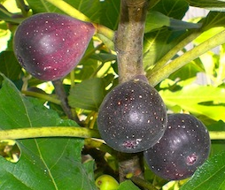
Fig
+ Very tasty
+ No-spray
– Must be eaten or processed soon after picking
– Can die back in colder winters
– Hornets, ants, and squirrels can be problems
– May split after rains, eye may let bugs in
Celeste and Hardy Chicago good: low-split, closed-eye
Figs are a Baltimore tradition in Little Italy

Slide 6
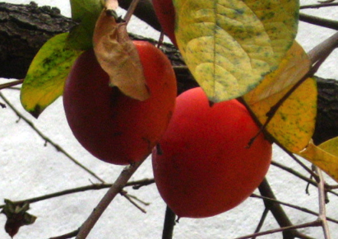
Asian Persimmon
+ Very sweet and rich flavor
– Not everyone likes the texture/taste
+ Even people not liking taste will like persimmon leather/pudding
+ Few problems with pests, no-spray
– Stink bugs can do minor damage on fruits
– Deer will eat fruits
Two sorts: astringent and non-astringent

Slide 7
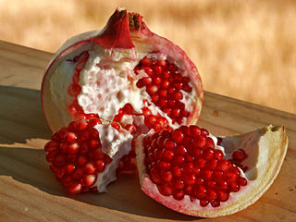
Pomegranate
+ A resurgent fruit today due to antioxidants
and yes we can grow it in Maryland!
– Only the most hardy varieties will be reliable
They are hard to find
Kazake, Salatsvaki, Russian 8, etc
+ No pests, they appear to be no-spray
– May die back in cold winters
– May crack as they ripen

Slide 8
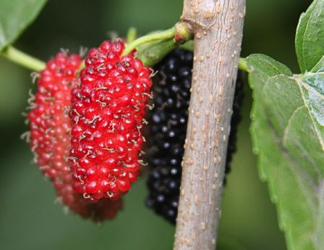
Mulberry
+ Very tasty, much better than wild fruits
+ No-spray and a large crop when mature
– Harder to harvest from a large tree
(put down a sheet and shake tree)
– Squirrels and birds love fruits, deer eat leaves
Varieties: Illinois Everbearing, Kokuso

Slide 9
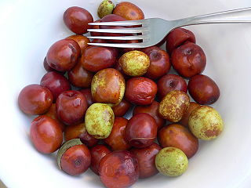
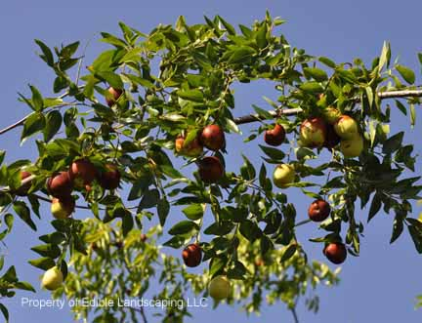
Jujube
Aka Chinese dates, when dried taste like dates
+ no-spray
+ Fresh fruit taste like an apple/date cross
+ Trees have attractive shiny green foliage
– May have problems with ants and cracking
Be sure to get fresh eating varieties
Li, Sugar Cane, GA866, Honey Jar

Slide 10
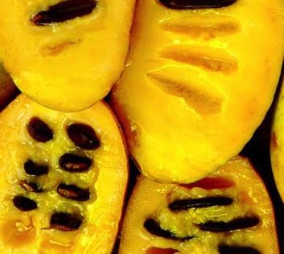
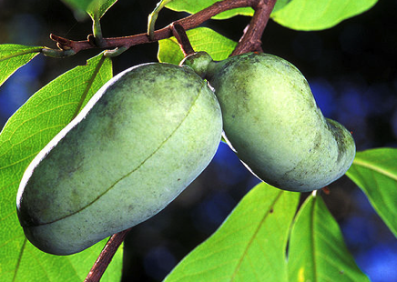
Pawpaw
+ A Maryland native fruit, no-spray and easy to grow
+ Tastes like delicious banana custard
– Tastes like tinny yucky slime to a few people
– Spoils quickly, need to eat in a few days of ripening
– Pollination can be dicey, need flies not bees

Slide 11
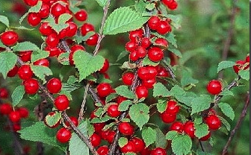
Bush Cherry
+ Similar to sour cherries but no-spray
– Seed is larger, hard to process them
Large bushes, not trees
Varieties: Nanking seedling; Crimson Passion, Carmine Jewel, Romeo, Juliet, Cupid, Valentine

Slide 12
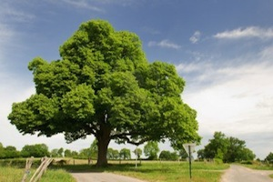
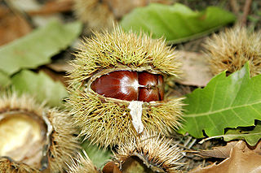
Chestnut
+ Very large trees, no-spray
+ Many pounds can be harvested
– Blight killed most of the chestnuts in the US.
+ Chinese chestnuts are generally blight-immune as are some US-Chinese hybrids

Slide 13
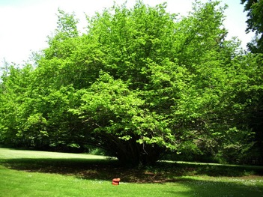
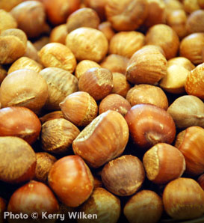
Hazelnut / Filbert
+ Easy to grow no-spray, tasty nuts
– Squirrels love them and it is hard to protect the trunks as they are multi-stem bushes.
– if you have squirrels and are not trapping them, pick something else to grow
– Blight is also a problem with filberts
Grow only blight-immune varieties
Yamhill, Jefferson, Santiam, Theta, …

Slide 14
Berries
+ Berries are in large part easy to grow
+ Some make wonderful landscaping
Blueberries, currants; grapes and kiwis on a pergola
– Some are hard to keep looking like weeds
Raspberries, blackberries
– Berries are particularly liked by birds
Strawberries are grown more like vegetables
In a raised bed; weeds are a significant issue
We will not cover them here

Slide 15
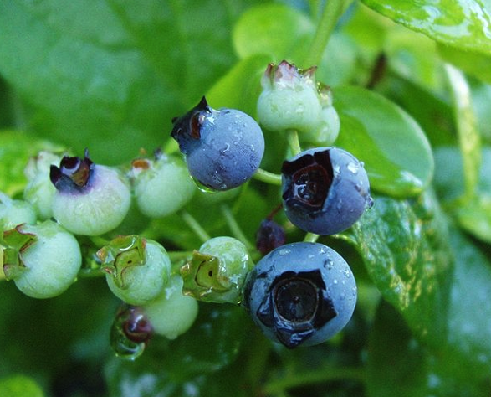
Blueberries
+ Very attractive landscape specimen, 5’ bush
+ Generally disease-free and no-spray
– Need to net for harvest to keep birds off
Scares not reliable
– The hard part is bed preparation; per plant add:
Around 1/2 cu foot of peat moss worked in
Elemental sulfur, about 2 cups per plant depending on soil pH
Need pH about 4.5-5; so, need some way to measure pH
Need to check and correct pH every 3-4 years
Varieties
Southern highbush and rabbiteye best

Slide 16
Raspberry and Blackberry
+ No-spray
– Somewhat prone to diseases and viruses
Always start a new bed with virus-free plants
In our climate 10 years or less is the lifetime
– Netting needed to keep birds off
Easiest route:
Erect thornless blackberries (no trellis required)
Fall raspberries (no trellis and just mow in winter)

Slide 17
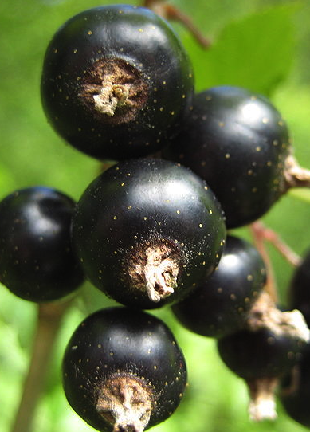
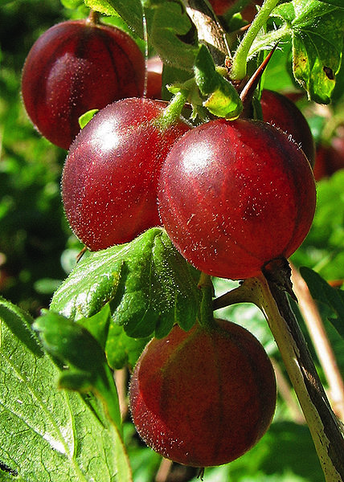
Currants and Gooseberries
Both are small bushes, 4’-6’
– May be restricted in MD soon unfortunately
White pine blister rust affects pines
Get WPBR resistant varieties
– Plants do not like heat
Recommend planting in partial shade
Get more disease-tolerant varieties
Some varieties work more reliably
Gooseberry: Poorman
Red Currant: Rovada, Jonkheer van Tets
Black Currant: Minaj Smyriou, Blackdown

Slide 18
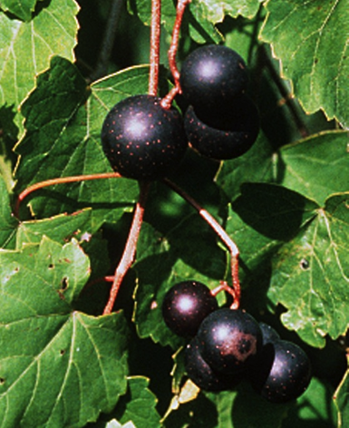
Muscadines
+ Very bug and disease resistant
+ Newer varieties are more sweet and flavorful
Supreme, Sugargate, Darlene, Black Beauty, Tara, Ison, etc
– Need to build a trellis to hold them
– Need to prune back heavily
– Usually but not always hardy
– Not the same as regular grapes
some people will not like

Slide 19
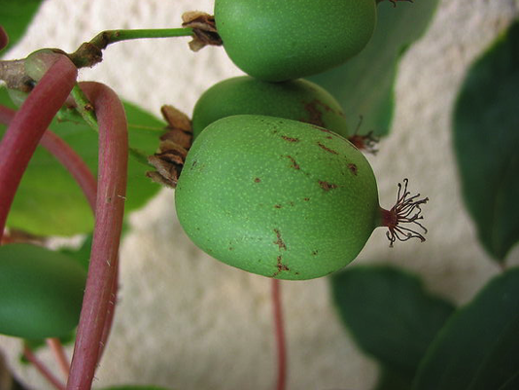
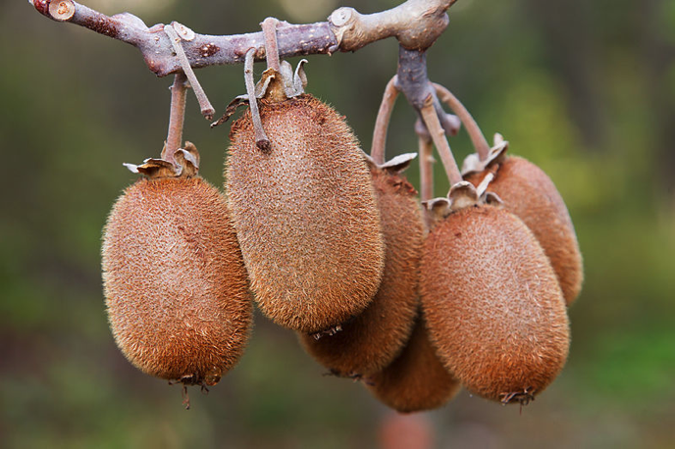
Kiwi
Kiwis are a vine crop
+ No-spray, few pests (stinkbugs are my only problem)
+ Two types, both can grow here
hardy (actinidia arguta), large grape size
fuzzy (actinidia deliciosa & chinensis), grocery store kind
– Similar to muscadines for care: trellis & prune
– Extremely vigorous: hedge back in May/June, July
– Male pollinator is needed which produces no fruit
– Leaf out very early, may get zapped by frost
– Many fuzzy varieties do not ripen here
Grow the Saanichton variety, it does – eat in February

Slide 20
Next: Some More Challenging Fruits
Standard “all in one” fruit tree spray is not going to work on half of the disease/bug problems
For organic its even more challenging
Path to success: scout–research–address all problems
Outline
Different spraying philosophies
The more challenging bugs
The more challenging diseases
One-by-one through the fruits

Slide 21
Philosophies on use of chemicals
No spray - I don't want to spray anything on my trees
Organic - I will only spray non-synthetic chemicals
IPM - I will spray synthetics but only what is needed, nothing more
Traditional - I spray a toxic concoction every two weeks, whether its needed or not
Why does it matter?
More spraying is more work
Bug killers can be highly toxic to humans and pets
Some sprays may damage fish when they run off to lakes

Slide 22
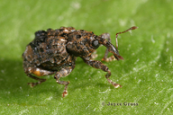
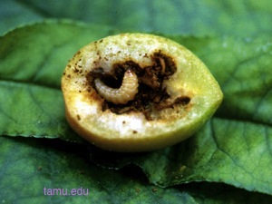
Plum curculio
A small weevil with a very strong shell
A huge problem on all pome/stone fruits
Will ruin every single fruit if not controlled
Organic control is Surround, a non-toxic clay powder spray
Need a constant coating, so re-apply after rains
Non-organic use pyrethrin (e.g. Triazicide), a poison

Slide 23
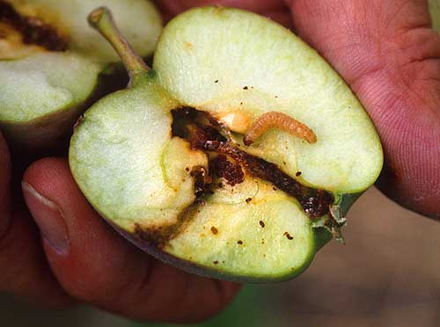
Moths
Oriental fruit moth and codling moth
Like curculio they are everywhere and will ruin fruits if not controlled (wormy fruit)
Hard to control organically
Cut off drooping peach shoot tips in May
Surround will help; also include some Bt and/or spinosad, an attacking bacteria/virus
Mating disruption works but hard to source
Bag individual fruits in ziplocs or organza bags
Not hard to control with a few well-timed pyrethrin poison sprays

Slide 24
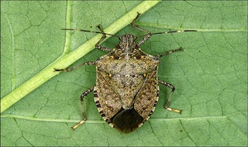
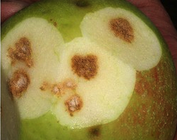
Stink bugs
Getting to be a big problem with the brown marmorated stinkbug invasion
Makes fruit distorted; particularly bad on peaches, asian pears, apples
Not easy to control without poison sprays
Surround spray and hand-picking are the organic options; still will get some damage
… And even more bug problems:
Peach tree borer moth, cherry fruit fly, pear psylla, aphids, scale, pear leaf blister mite, etc

Slide 25
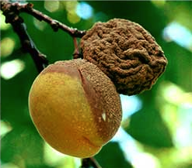
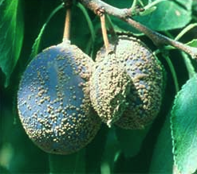
Brown rot of stone fruit
A devastating disease, ripening fruits rot
Starting growers get lulled by early success
Takes about five years to really kick in
Very hard to control organically
Even with synthetics it requires multiple sprays of hard-to-find chemicals such as propiconazole
For low-spray growing, type and variety selection is key
apricots ripen earlier and often avoid it entirely, same for cherries
Japanese plums and some peaches can be fairly resistant
European plums are all highly susceptible

Slide 26
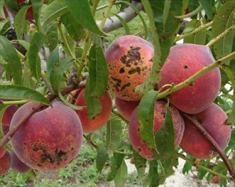
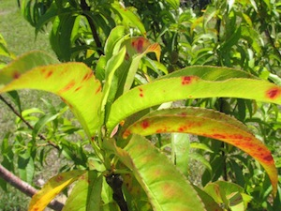
Bacterial spot
Can defoliate trees and spot fruits
Requires copper spray in spring and fall to control
Important to seek out resistant varieties
Other big disease problems on stone fruits:
Peach scab, bacterial canker, black knot

Slide 27
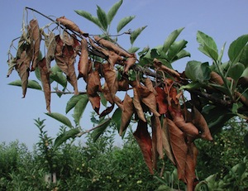
Fireblight of pome fruits
One day you have a nice tree, next day you have crispy shoots
Highly capricious, can stay away for years and then devastate in one day
No great sprays; copper early in season can help
Prune it out fast!!

Slide 28
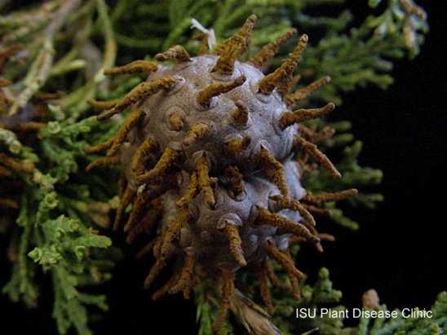
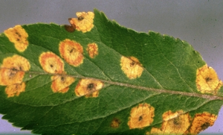
Cedar Apple Rust
Bright orange spots on leaves and bumps on fruit
Its often just cosmetic
Impossible to control organically, must cut down nearby junipers
Specialized synthetic sprays will control
Select resistant varieties

Slide 29
Now for the challenging fruits
Pears
Sour cherries
Japanese plums
Apricots
Peaches
Apples
European plums
Sweet Cherries
– Challenging, but rewarding if it works

Slide 30
Pears
Asian Pear
+ May be possible to grow with no or very few sprays
– Stinkbugs can be a huge problem on Asian pears
– Many other diseases and pests can wreak havoc:
fireblight, pear psylla (though more of a problem on Euros), pear leaf blister mite, codling moth, plum curculio.
European Pear: similar to Asians except
– They take much longer to fruit
– Hard to ripen properly
requires early picking - cold storage – ripening
– Somewhat less disease and bug tolerant

Slide 31
Sour cherries
+ May be possible to grow with few sprays
+ A great fruit for cooking or drying
– Can have problems with curculio and moths, but less attractive than other stone fruits
+ Trees are self-fruitful unlike sweet cherries, so only one tree is needed
– Birds will clear the tree if they are not controlled

Slide 32
Japanese plums
+ Good plums are never found in stores, you will be surprised how tasty plums can be
+ If you can beat back the plum curculio and moths, they can be relatively easy to grow
– Brown rot is a problem on some varieties; get highly disease-resistant varieties
Varieties : Satsuma, Santa Rosa, Ruby Queen, Shiro, Methley, etc

Slide 33
Apricot
+ Similar to Japanese plums in terms of difficulty; even more of a taste treat
– Early blooming so spring frost can wipe out crop
Variety: Tomcot - superior to others in all dimensions (reliability, taste, lack of diseases)

Slide 34
Peaches
+ Much more tasty than store-bought peaches
+ Peaches like heat so in some ways they are happy in our climate
– Moths, curculio and brown rot are HUGE challenges to overcome
– Squirrels LOVE peaches
– Many other problems as well: peach tree borer, peach scab, bacterial spot, etc.
Varieties: Most varieties from eastern nurseries are OK

Slide 35
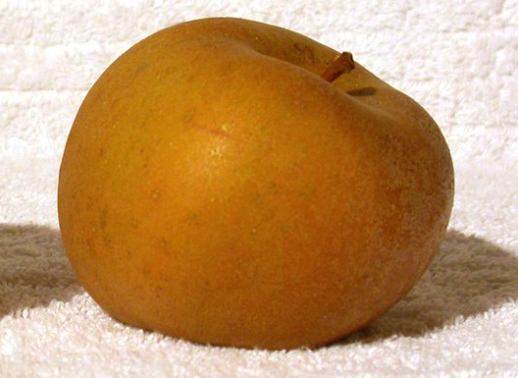
Apples
– They prefer a cooler climate
You are fighting against nature growing them
– See above for moth, fireblight, cedar apple rust problems
– Also many other problems: aphids, apple scab, etc
+ Home-grown apples are better than store versions, you can ripen them fully
+ There are many unusual varieties to grow
GoldRush, Williams Pride, Rubinette, Golden Russet

Slide 36
Last but not least
European plums
– Huge brown rot problem on all varieties, on top of all the usual problems
– Can take many years to fruit
Sweet Cherries
– The trees greatly dislike heat
– Trees can get bacterial canker and die
Variety selection critical: get Black Gold, White Gold

Slide 37
Obtaining Fruit Trees
Local nurseries have limited selection
Valley View, Sun Nurseries are best?
Mail-order works well; required for some fruits
Most mail-order places are reasonable; some are bad and some are great
Avoid: TyTy, Aarons, Nature Hills, Willis
My list of good places: seehttp://scottfrasersmith.com/fruits

Slide 38
Care of Young Fruit Trees
Soil
Avoid heavy clay and poor drainage and you should be OK
Location
Fruit trees MUST have 6-8 hours of sun per day
Don't plant at the bottom of a hill or in a dip in a very flat area - frost pocket
Planting
Dig a hole bigger than all the roots
Avoid the urge to amend the hole with anything
Put wood mulch on top in a 3' circle, and keep weeds away
Watering
If 1/2” deep into the ground it is still dry, water
Overwatering can be as big a problem as under-watering

Slide 39
Annual care of fruit trees
Overarching point
Happy trees resist bugs and diseases
Keep trees happy and you will have a third of the problems
Fertilize in spring
a shovel of compost and a handful of 5-2-5 or similar
Water in prolonged dry spells (only)
Mulch with wood bark annually, keep weeds away
Prune annually
Thin out the branching structure - "a bird should be able to fly through it"
Head the top if you want to keep the tree pedestrian height
Pruning is an art taking years to perfect

Slide 40
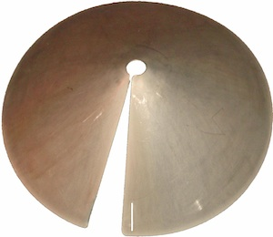
Squirrels (& Rats)
Squirrels don't share - they will take every last fruit on the tree
They will gladly eat most types of fruit
Control
If trees are isolated from other higher obstacles can baffle the trunk
If not, you will need to trap them (Havahart, Kania brands)
Trapping is a skill that takes practice and perseverance

Slide 41
Birds
Birds love berries and cherries
Apples, peaches, and plums will get pecked on
Controls that work
Net the trees top to bottom when the fruit is ripening
Put up scares right as the fruit is ripening, take down right after
I use old CDs/DVDs on string with good results
Can get used to anything left out too long

Slide 42
Deer
A horrendous problem in recent years
Lower shoots nibbled away, fruit within reach eaten, bark rubbed off
Controls that work
8' deer fence around the entire orchard area
Protection of individual trees with 6' hi x 3'-6' dia. cage
Let trees grow to be above deer height
ScareCrow motion-activated sprinklers
Controls that may or may not work
Sprays, hanging soap, deterrent bags, zappers

Slide 43
Resources
See http://scottfrasersmith.com/fruit
Links to useful online guides, etc.

